Slide 1
Helios
By Aliya Chambless, Tyler Jacobson, Stephen Sun

Slide 2
The Problem: User & Precedent Research
Ambient light outside may make it difficult for people to fall asleep
People may still want to be woken up by the sun…
… but not at break of dawn
People may want to open/close the shades only for a limited time without having to move
Daytime nap, while changing, for insulation, during a Zoom meeting, etc.

Slide 3
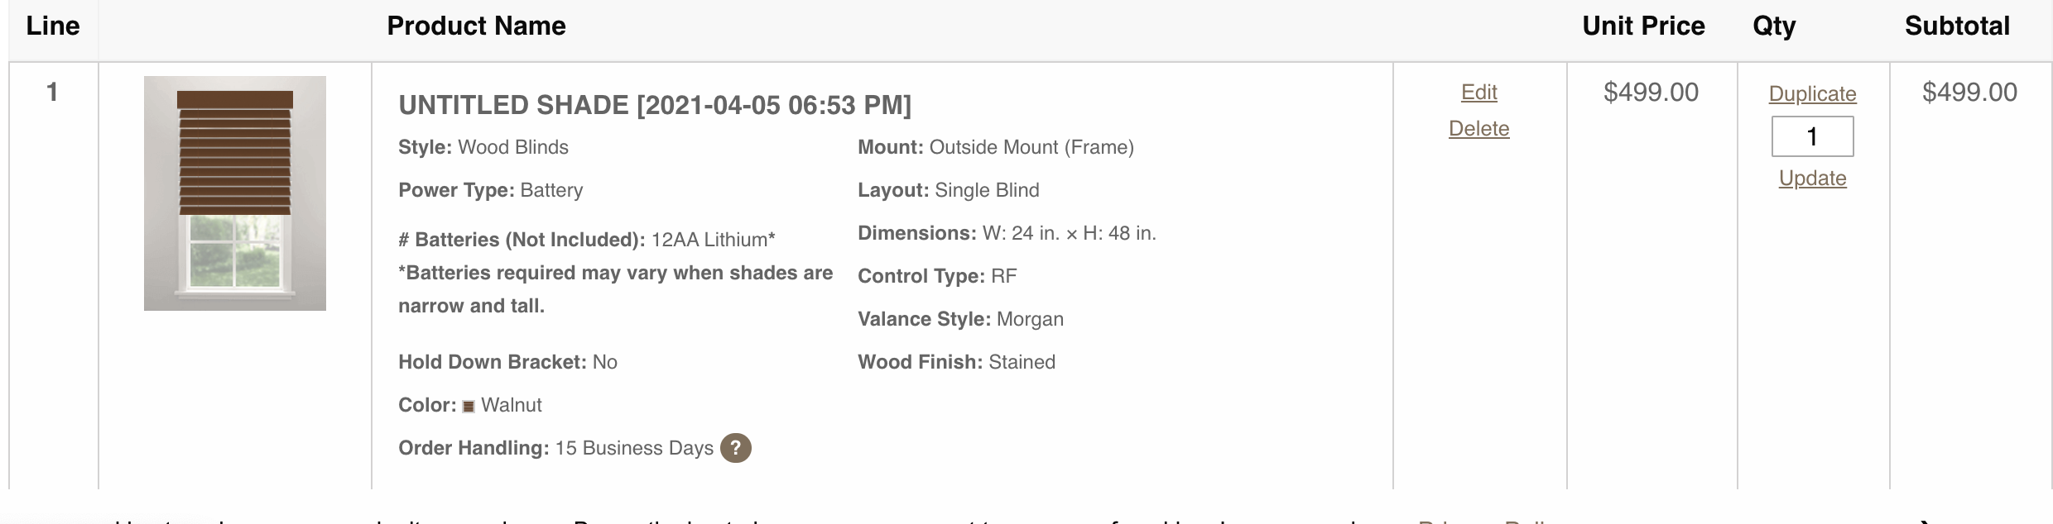
The Problem: User & Precedent Research (cont.)
Smart shades exist, but are expensive ($100s+)
Some require smart home system (above)

Slide 4



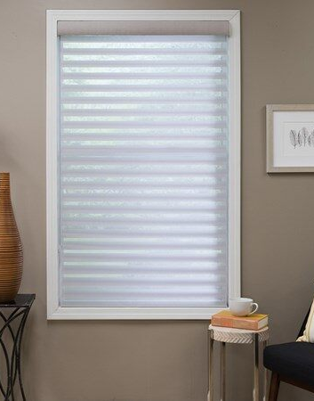
Helios
The Integrated, Inexpensive Smart Shade & Alarm System

Slide 5
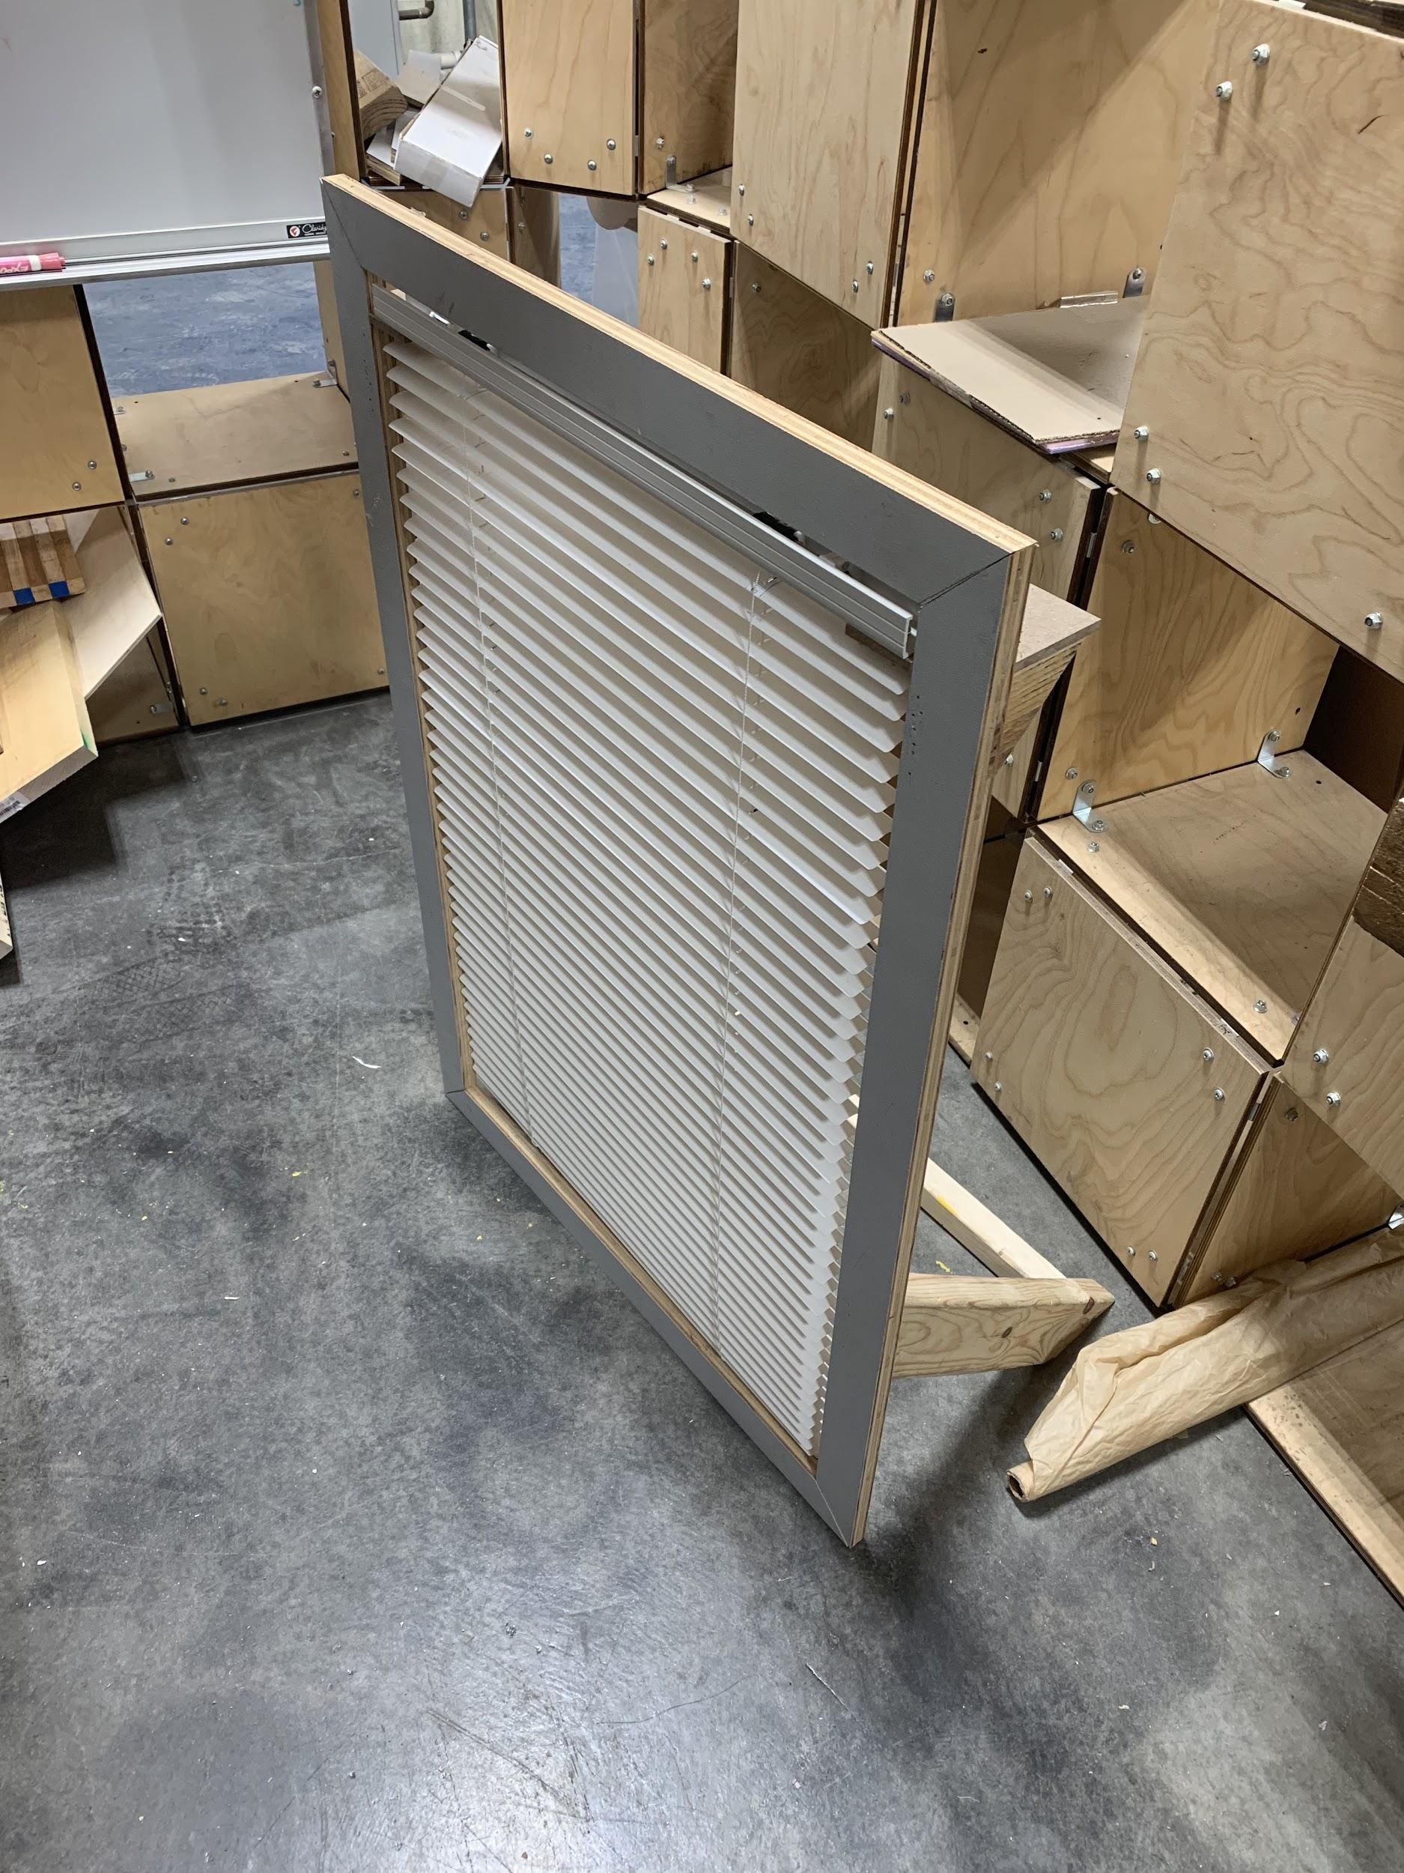
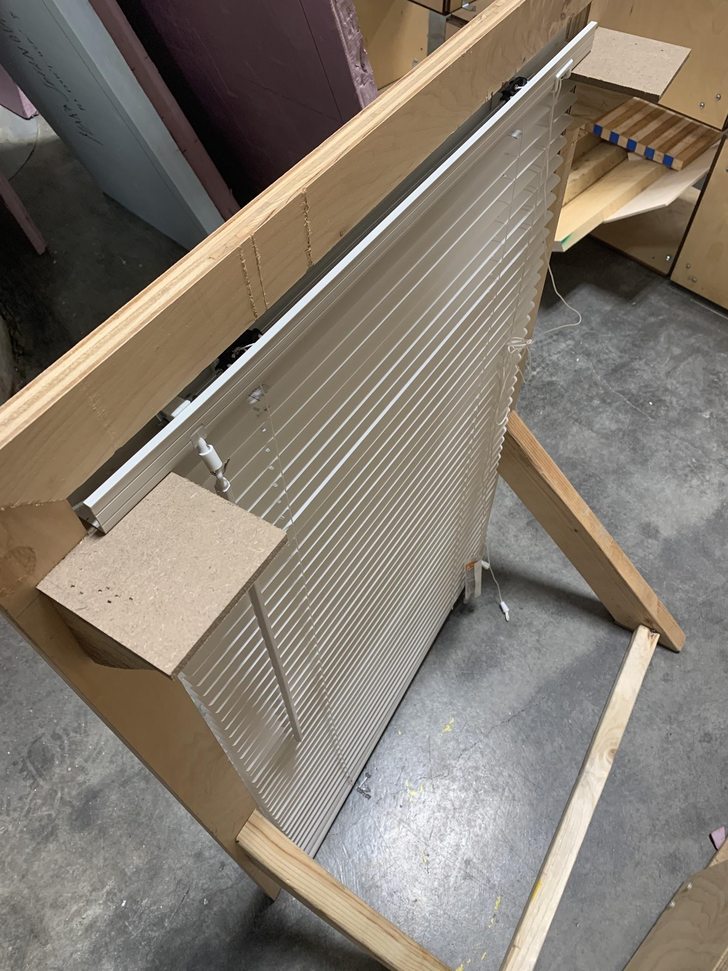
Mechanical Build - Constructing Frame

Slide 6
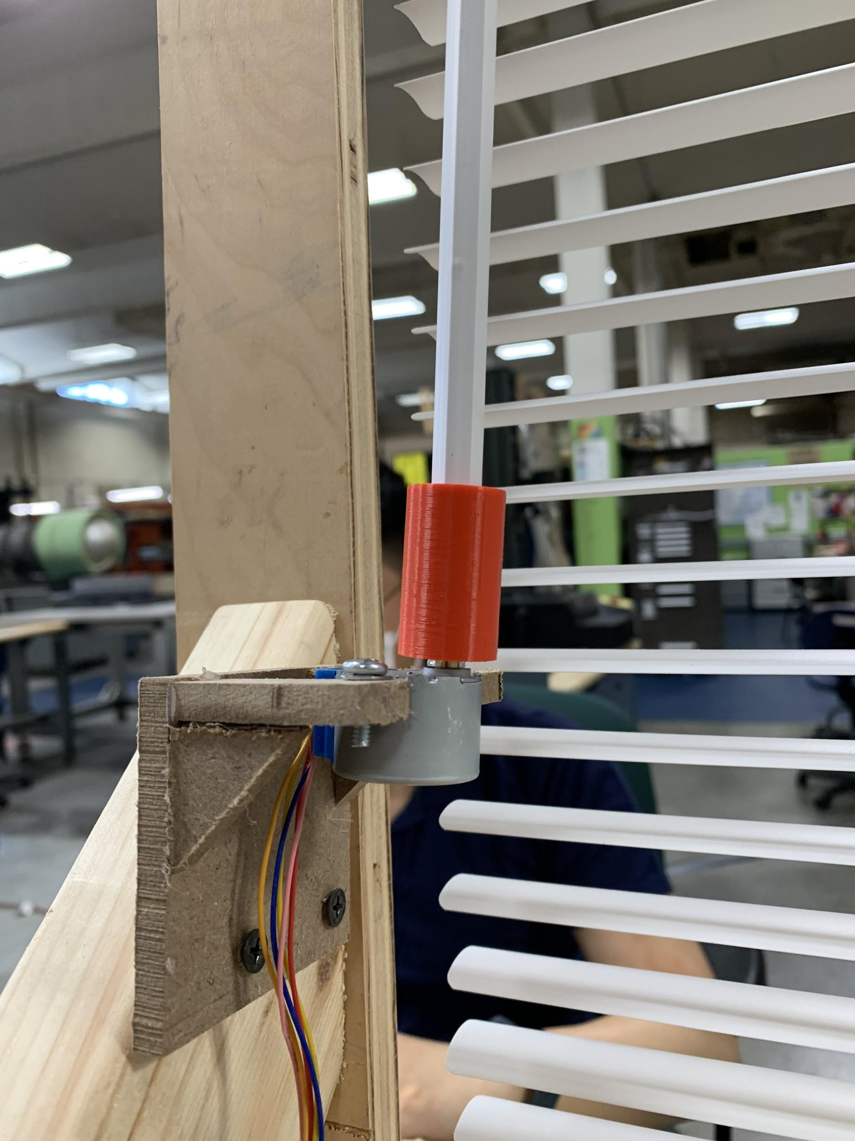
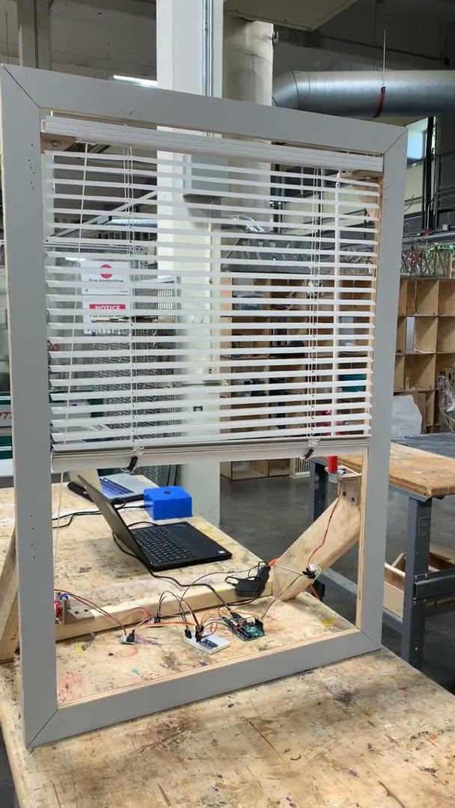
Mechanical Build - Rotation Control

Slide 7
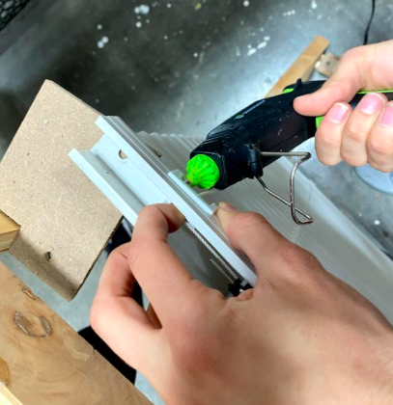
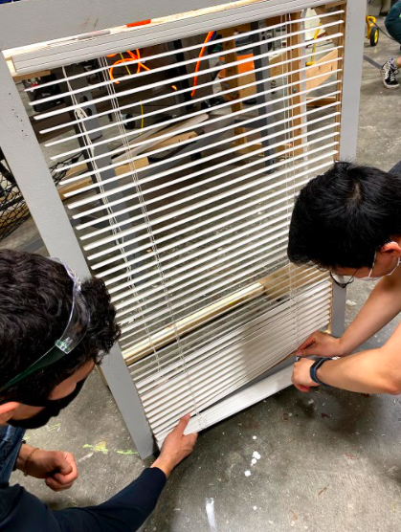
Mechanical Build - Raising & Lowering Blinds

Slide 8
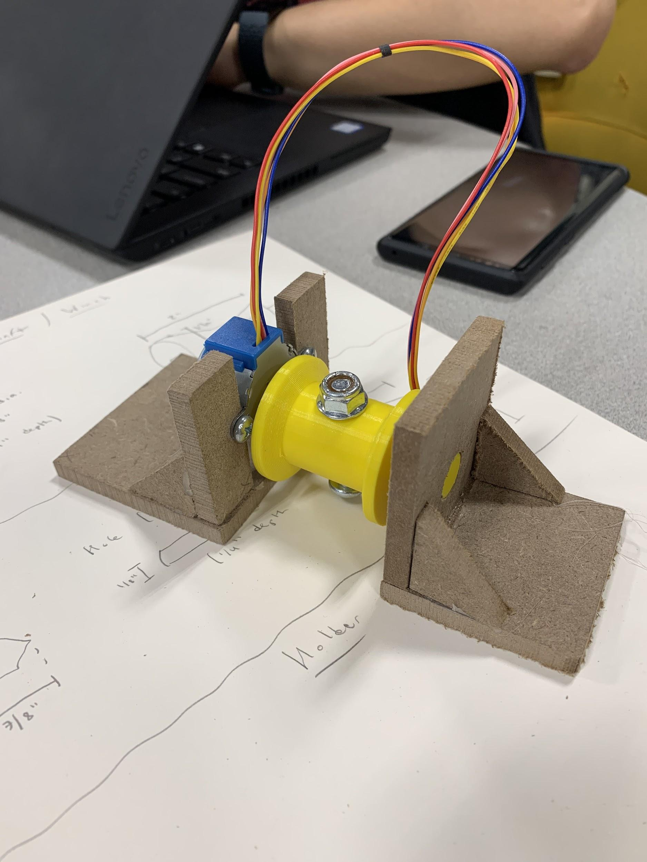
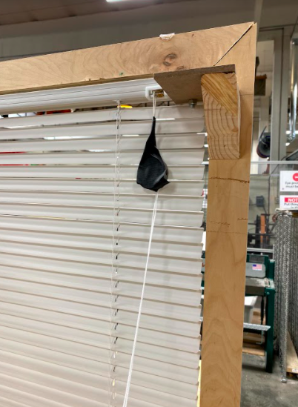
Mechanical Build - Raising & Lowering Blinds (cont.)

Slide 9
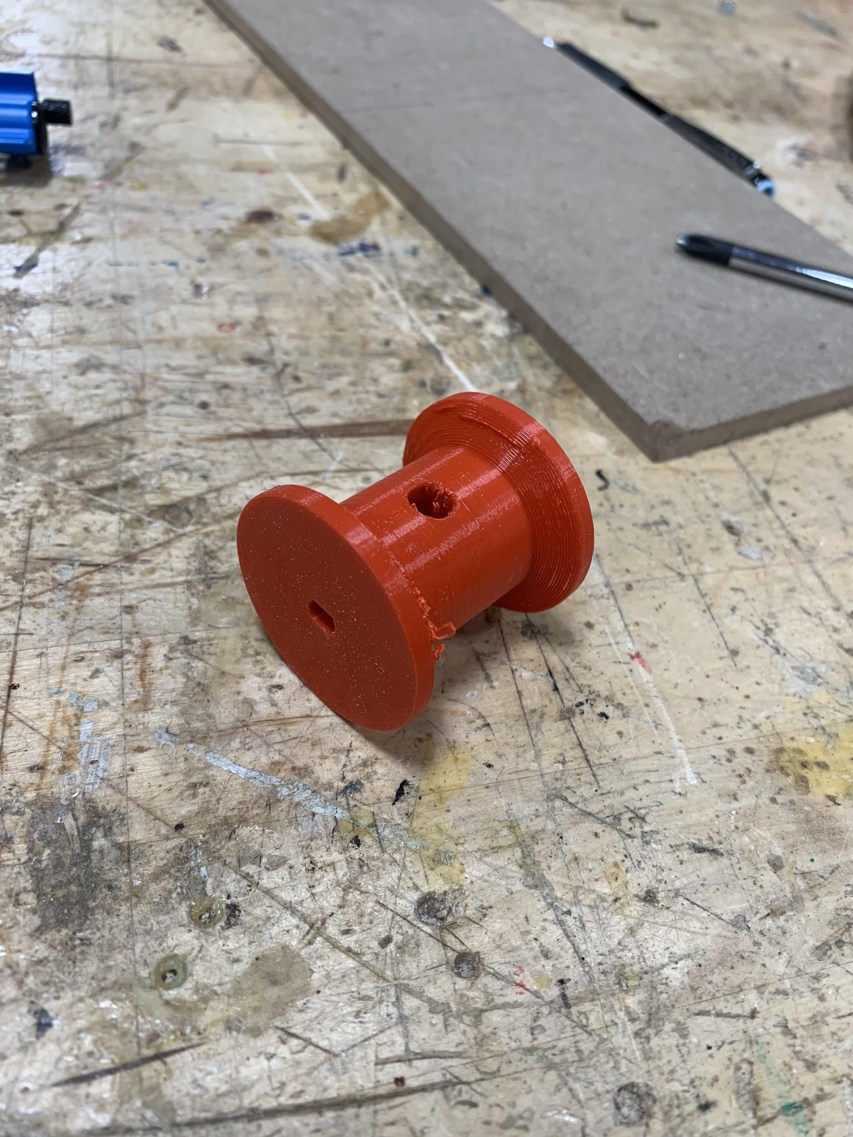
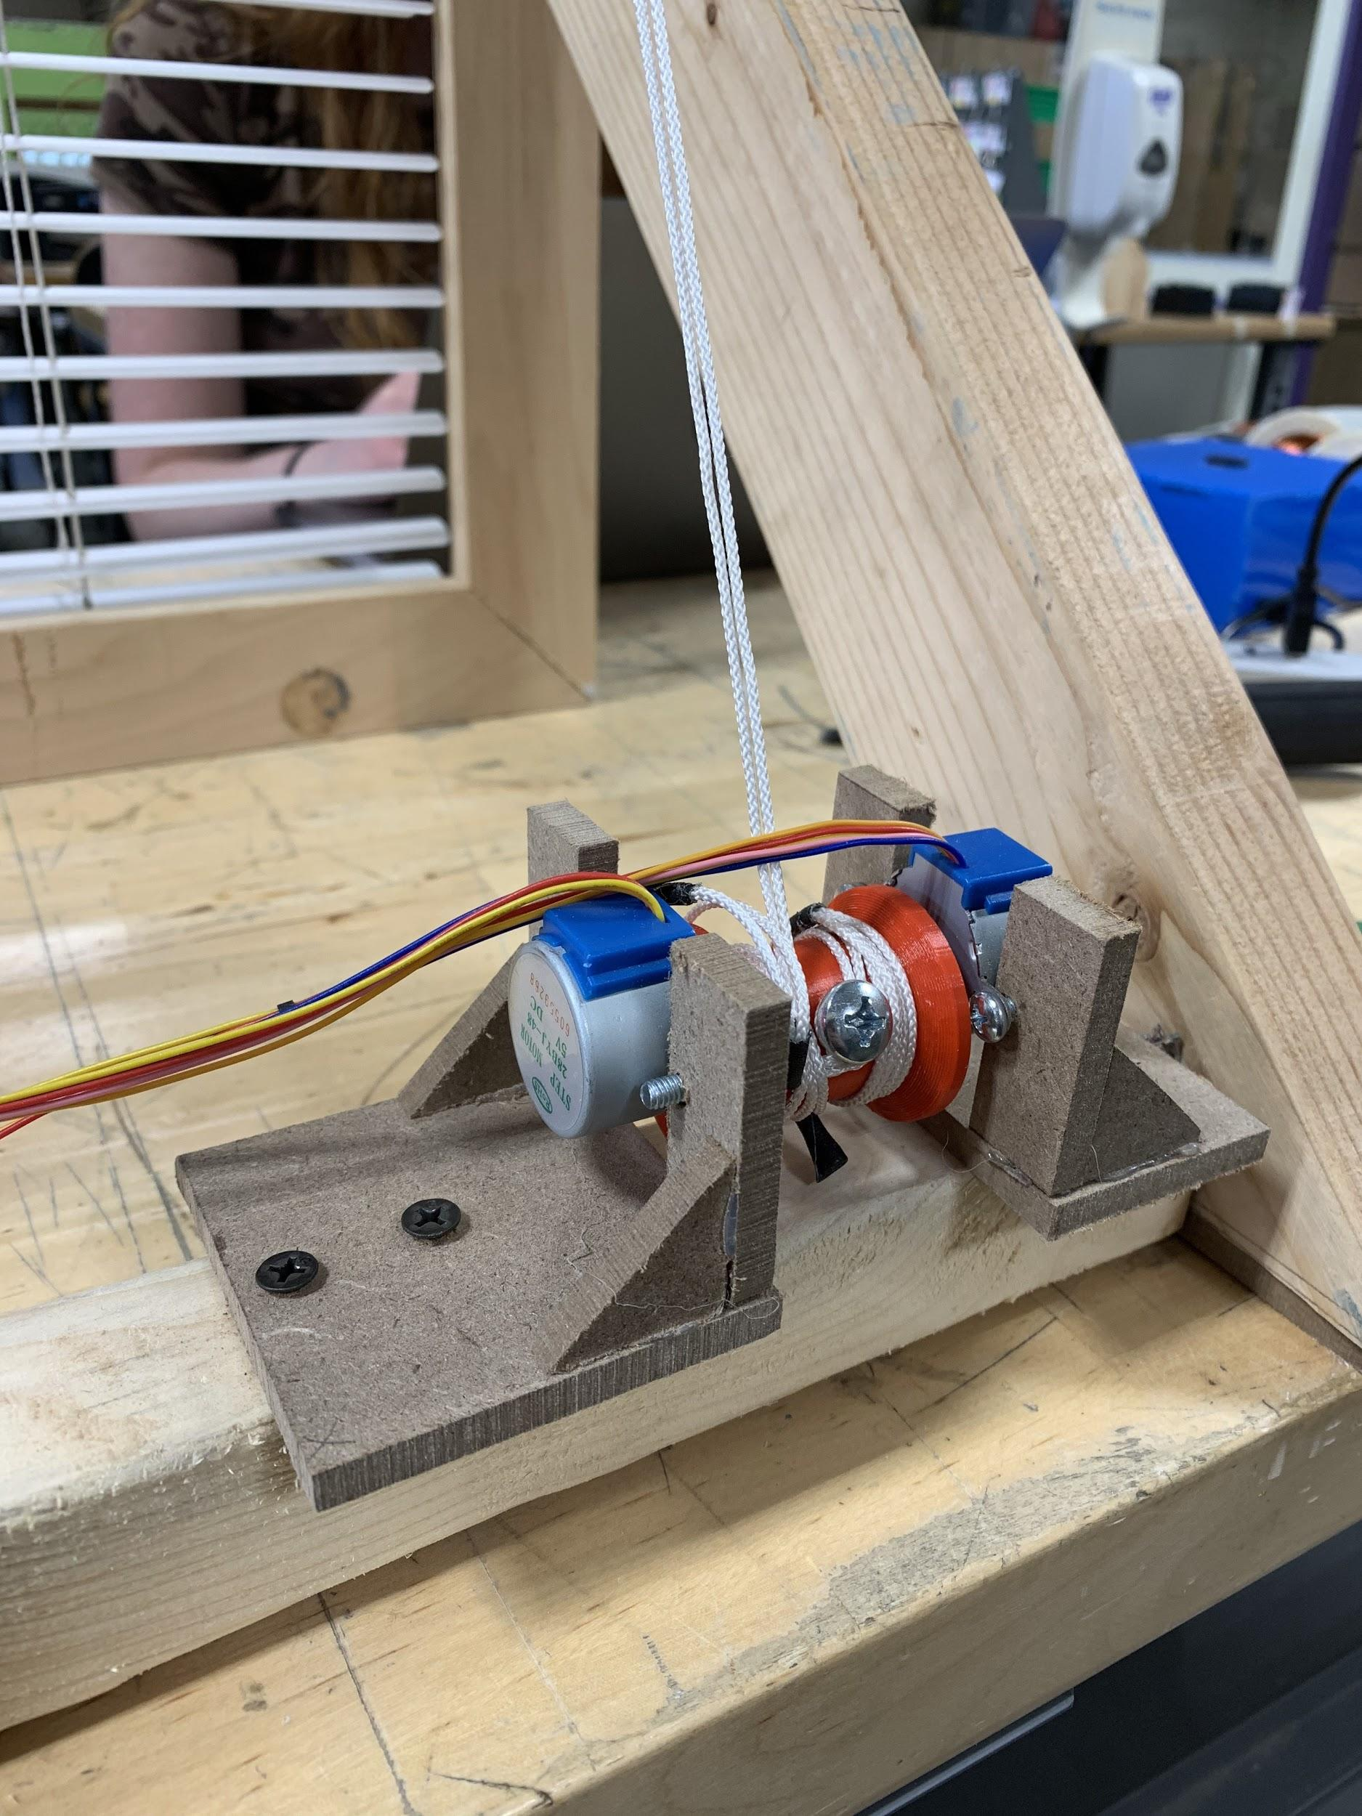
Mechanical Build - Raising & Lowering Blinds (cont.)

Slide 10
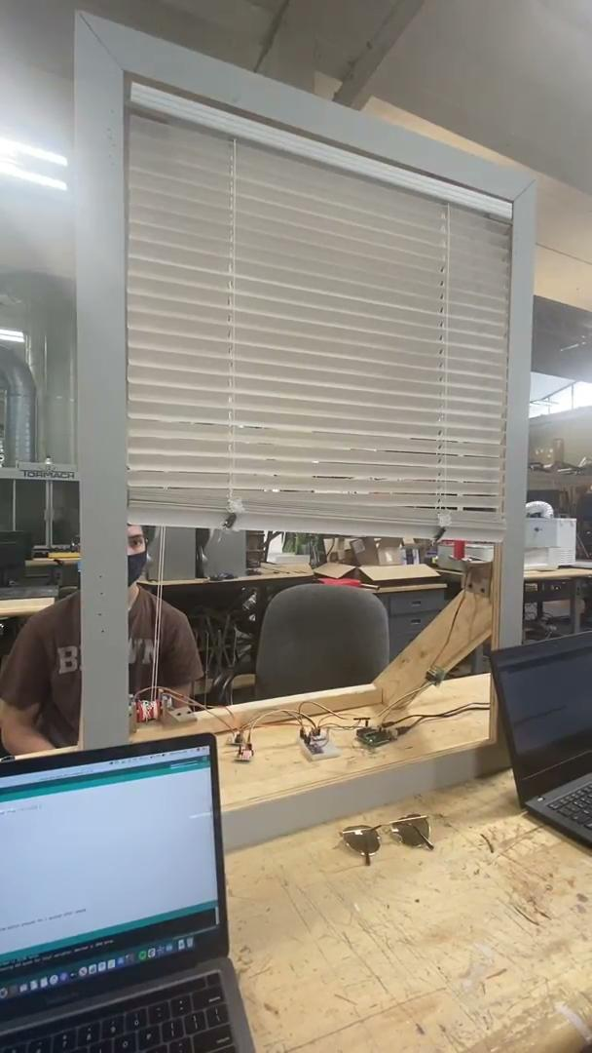
Stepper Motors
1 stepper not strong enough to raise/lower blinds at all
Default stepper library only allows 1 stepper motor to move at a time
Workaround: Setting up 2 steppers to work in parallel - reversing the connections to change the direction

Slide 11
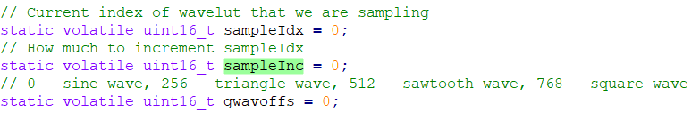
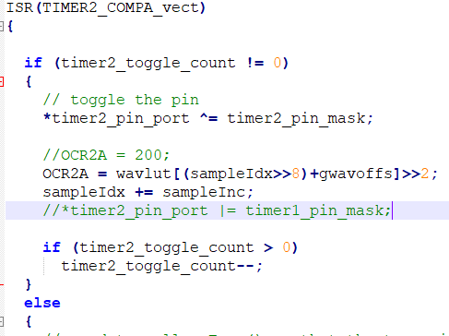
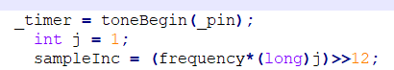
Alarm Tone
Original signal processing did not work with the LCD library
Used the built in tone library instead
Modified tone library to output sine wave

Slide 12
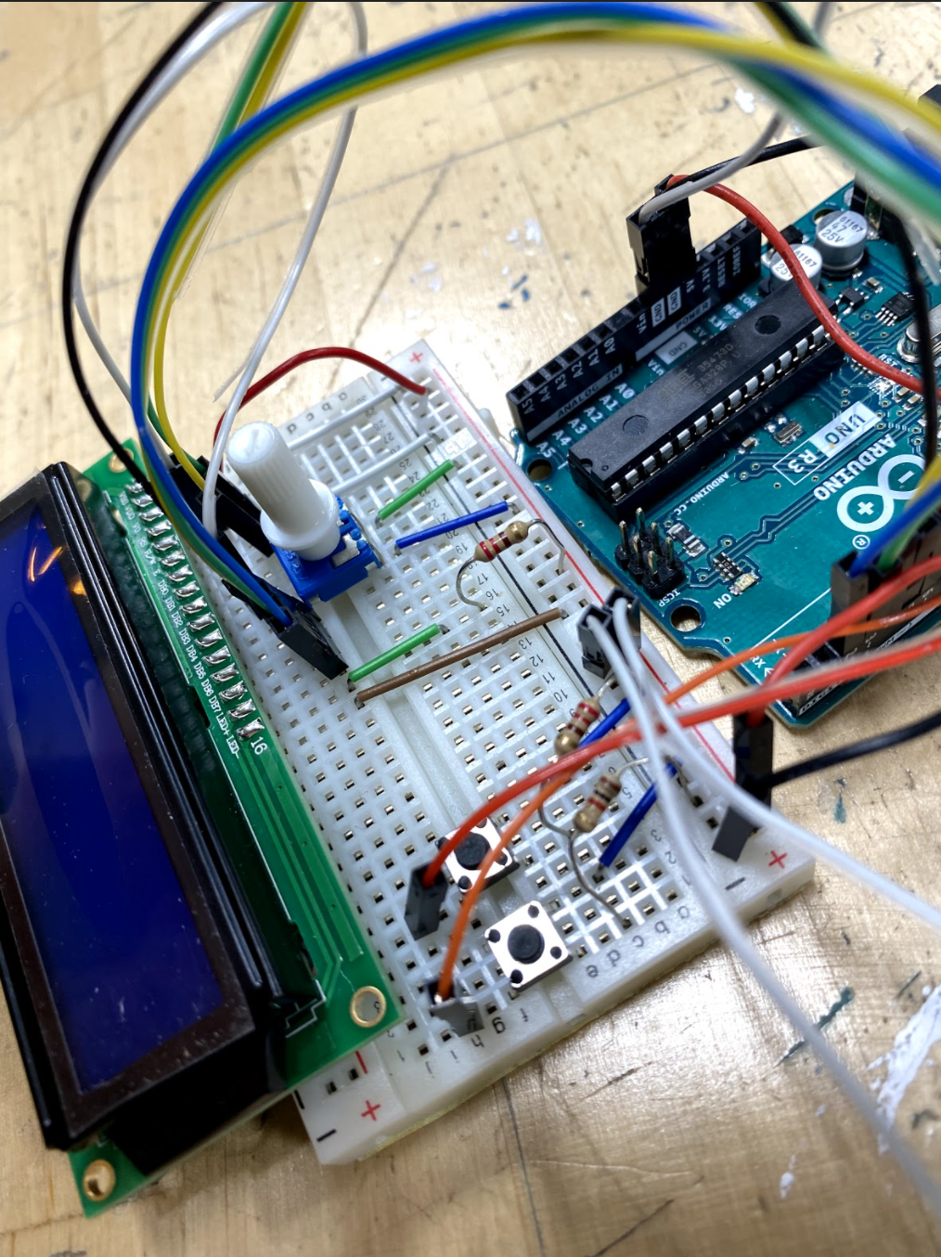
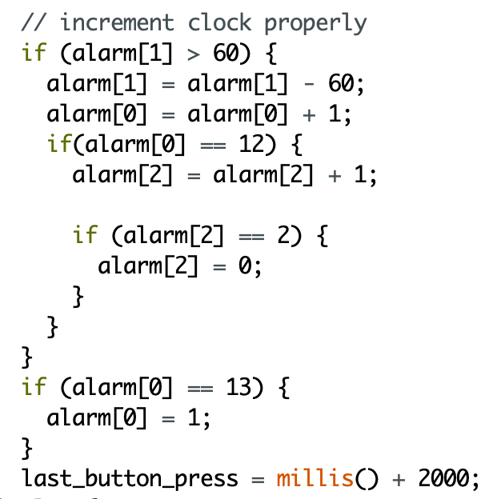
Alarm Clock Display Code
Used millis() instead of delay() to track seconds so buttons can be pressed any time
Tracked hours, mins, seconds, and am/pm
am/pm flag changes at 12, hour resets at 1
Calculates alarm from voice control data, sends open / close command on alarm and snooze

Slide 13
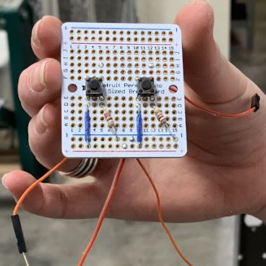
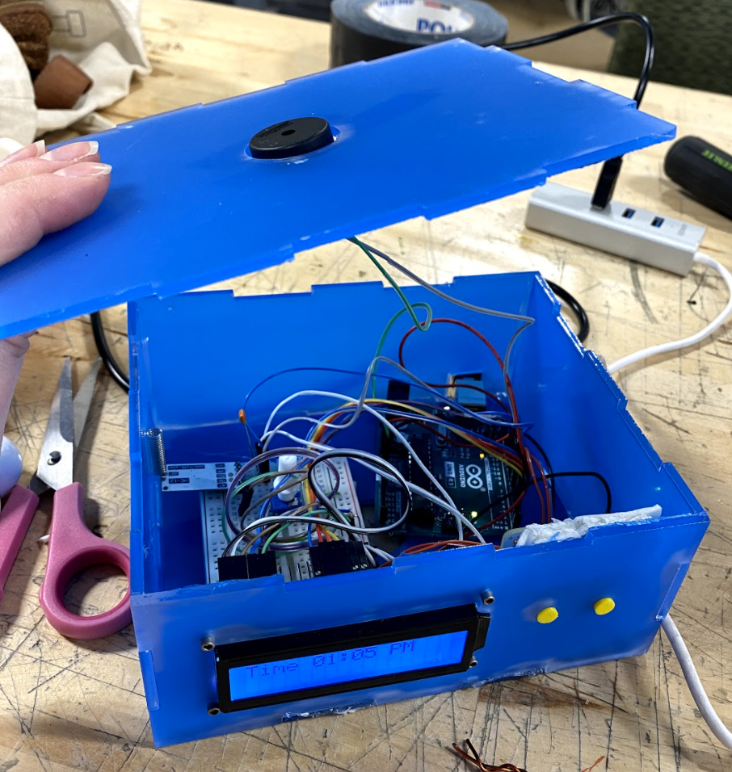
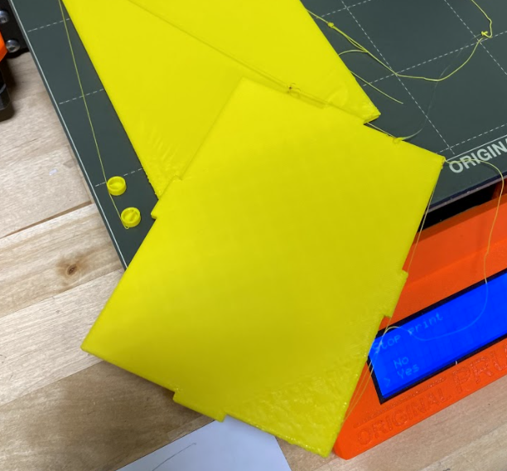
Alarm Clock Build
Potentiometer to control screen brightness
Buttons to set time, snooze, and stop alarm
Soldered buttons to ¼ size breadboard
3D print failed, laser-cut instead

Slide 14
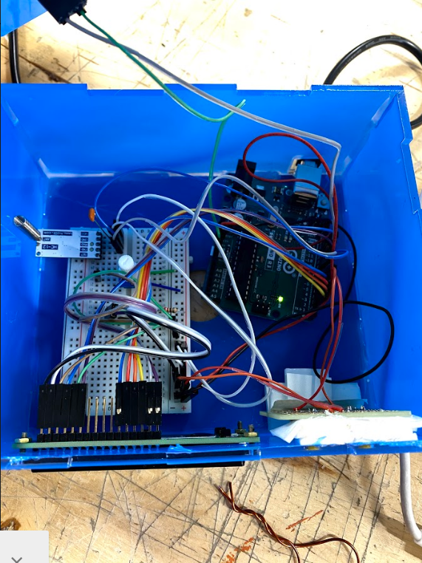
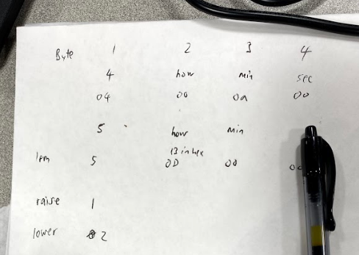
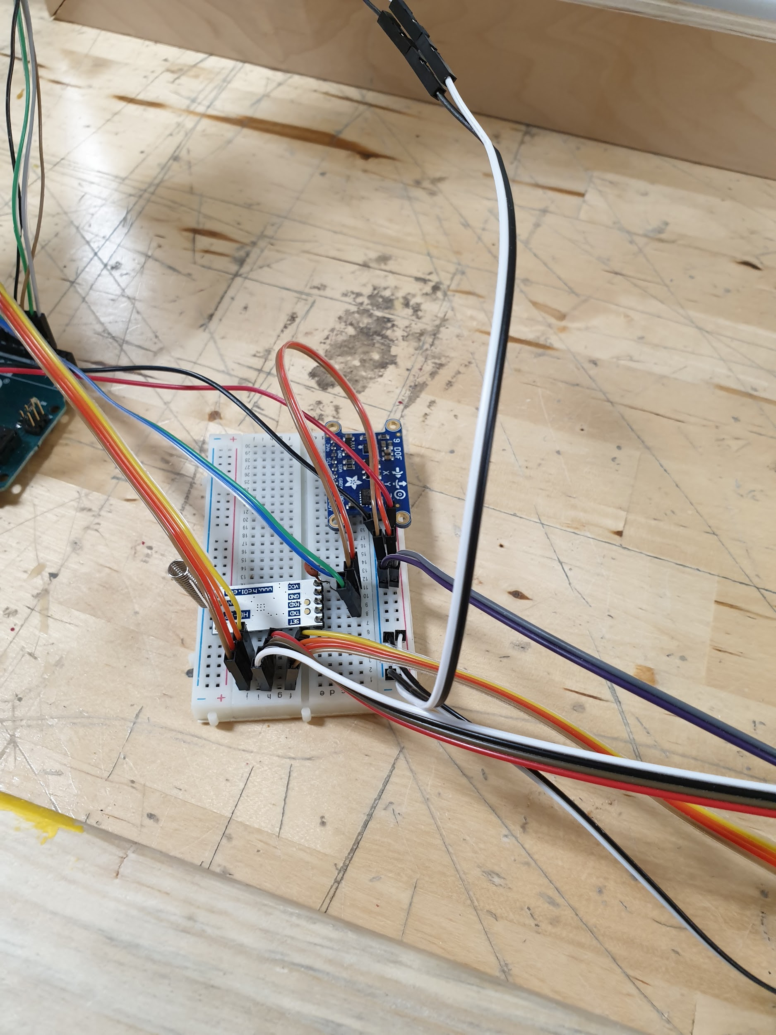
Wireless Communication
HC12 wireless communication chip
Uses SoftwareSerial to send/receive byte data
Defined a specific data format for transmitting data between the 2 Arduinos

Slide 15

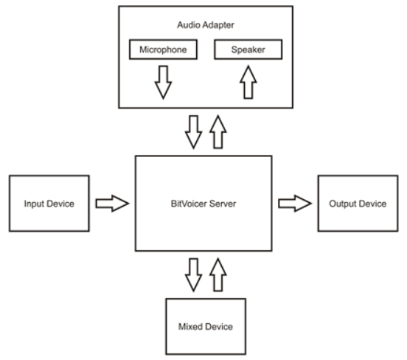
Voice Control
Expanded upon what we had from project 3
Voice control used to control blind movement, rotation and alarm
Laptop with microphone as input device, Arduino as output device

Slide 16
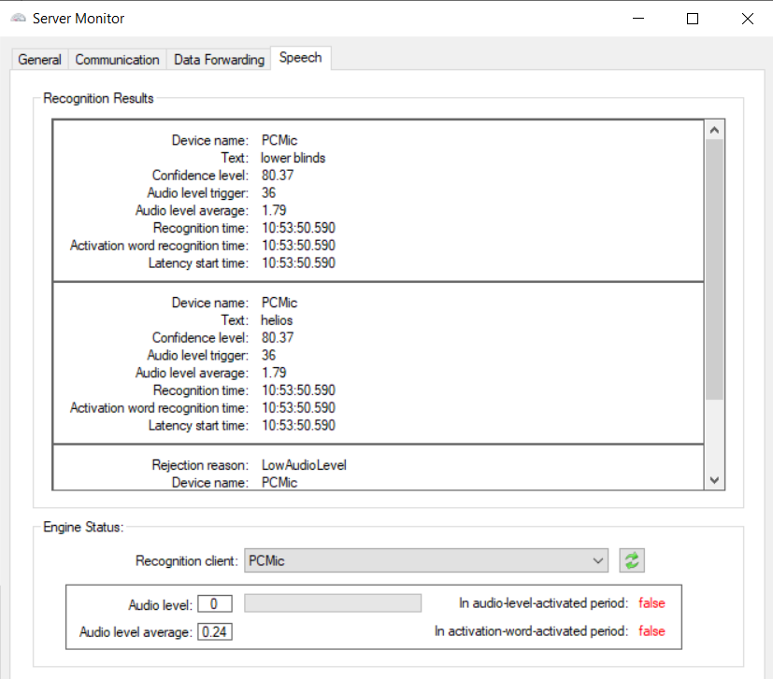
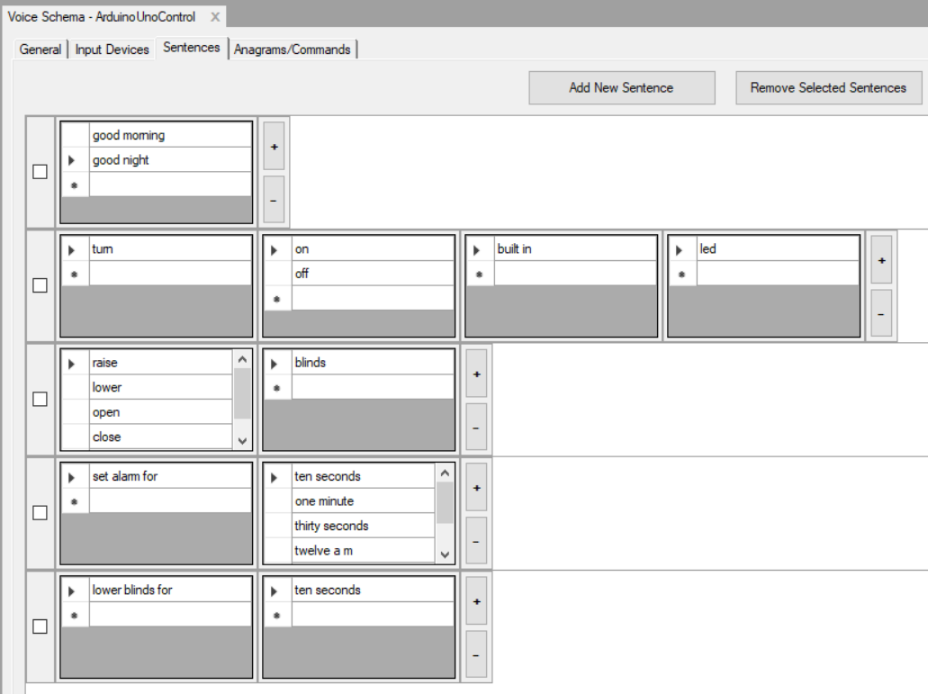
Voice Control (cont.)

Slide 17
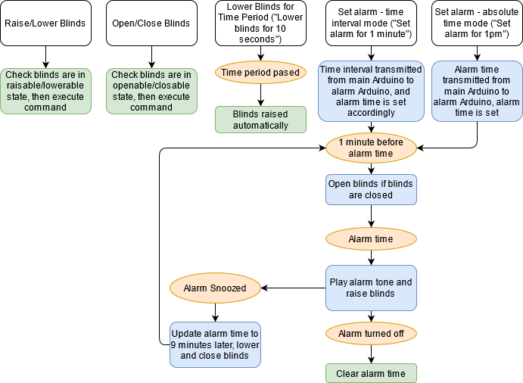
Functionality Flow Chart

Slide 18
Demo!

Slide 19


